Slide 1



Student Details
Name: Shubham Kumar Jha
Email: senshubham284@gmail.com
AICTE Id: STU61c7440d19e851640449037
Organization: DGT
College Name: College Of Engineering Roorkee
Domain: Data Analytics
Start Date: 12 June 2023
End Date: 24 July 2023
Internship Name: IBM SkillBuild
Foundation: Edunet

Slide 2

Analysis of Superstore Dataset
PROJECT TITLE

Slide 3

Project Title: Analysis of Superstore Dataset
Introduction: The goal of this project is to analyze the Superstore dataset to gain
Data Collection and Preprocessing: Collect and preprocess the Superstore dataset
Sales Analysis: Analyze sales metrics, trends, and factors influencing sales fluctuations
Customer Behavior Analysis: Study customer demographics, preferences, and
Operational Efficiency Analysis: Evaluate operational efficiency, identify bottlenecks
Conclusion and Next Steps: Summarize findings, plan for advanced analysis, predictive

Slide 4
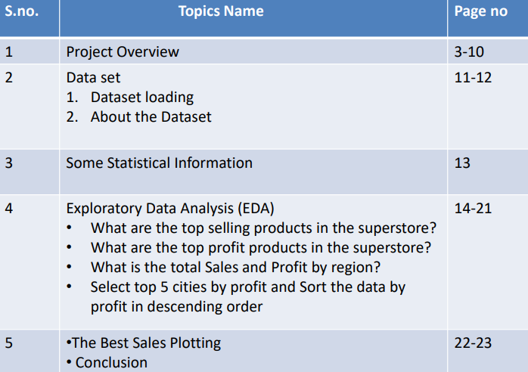

AGENDA

Slide 5
Project Overview
The analysis on Superstore dataset is a comprehensive study that aims to analyze the sales performance of a fictional retail company called "Superstore". The dataset used in this analysis contains information about sales transactions, customers, products, and geographical locations. The analysis involves using Power BI, a data visualization and reporting tool, to create interactive dashboards and reports that provide insights into the sales performance of Superstore
Purpose: The purpose of the "Analysis of Superstore dataset" is to gain insights into sales trends, customer behavior, and operational efficiency in order to optimize store performance and make data-driven recommendations for improvement.
Scope: The scope of the analysis includes examining the Superstore dataset, which consists of sales transactions, customer demographics, product categories, and geographical regions. The analysis will involve data cleaning, exploratory data analysis, sales analysis, customer behavior analysis, and operational efficiency analysis.

Slide 6

Objectives
•Identify sales trends, such as seasonal patterns and fluctuations, to optimize inventory management and sales forecasting
•Understand customer behavior by analyzing demographics, preferences, and purchase patterns to develop targeted marketing strategies and enhance customer satisfaction
•Provide data-driven recommendations to optimize store performance, improve customer experience, and increase overall profitability based on the analysis findings

Slide 7

WHO ARE THE END USERS

Slide 8

Target Audience or End Users
•Store Managers: They require insights on sales performance, customer behavior, and operational efficiency to make informed decisions and optimize store operations
and buying patterns to develop targeted marketing campaigns and improve customer

Slide 9
Characteristics and Needs
•They seek comprehensive data analysis, visualizations, and actionable recommendations to identify areas for improvement, enhance profitability, and streamline operations

Slide 10

Benefits from the Solution
•They will benefit from optimized inventory management, improved sales forecasting, and streamlined operations, leading to increased profitability and better customer and improved customer retention, resulting in increased sales and brand loyalty

Slide 11

Solution and its value proposition
The solution for the "Analysis of Superstore dataset" project involves conducting a comprehensive analysis of the Superstore dataset to gain insights into sales trends, customer behavior, and operational efficiency. This analysis will be carried out using various statistical and data mining techniques, as well as advanced visualization tools.
• Value Proposition: Our solution provides the following value propositions:
• Data-Driven Decision Making: By analyzing the Superstore dataset, we enable data-driven decision making for store managers and marketing managers. They can make informed decisions based on comprehensive analysis, leading to improved store performance, optimized operations, and targeted marketing strategies.
• Enhanced Profitability: Our analysis helps identify opportunities for increasing sales, improving inventory management, and reducing costs, ultimately leading to enhanced profitability for the Superstore. By optimizing pricing strategies, identifying high-demand products, and streamlining operations, the store can maximize its revenue and profitability.
• Competitive Advantage: Leveraging the power of data analysis, our solution provides the Superstore with a competitive advantage in the market.

Slide 12

Customize the project and make it my own
Advanced Visualization with Matplotlib and Seaborn: While data visualization is a common component of data analysis projects, my solution stands out by utilizing the powerful libraries Matplotlib and Seaborn
By leveraging the capabilities of Matplotlib and Seaborn, my solution presents data in a visually engaging manner, enhancing the understanding of complex patterns and relationships within the Superstore dataset
These dashboards allow stakeholders to dynamically explore and interact with the analyzed data, enabling them to drill down nature of the dashboards enhances engagement, facilitates deeper insights, and empowers users to derive actionable recommendations effectively

Slide 13

Modelling techniques, methodologies, and frameworks were applied:

Slide 14
Exploratory Data Analysis (EDA):
These techniques helped in understanding the impact of various factors on sales, customer behavior, and operational efficiency
libraries were used to create visually appealing and informative charts, graphs, and dashboards
These modelling techniques, methodologies, and frameworks formed the foundation of the "Analysis of Superstore dataset" project for Data Analytics, ensuring a systematic and data- driven approach to extract valuable insights from the dataset
Data Visualization:
Advanced data visualization techniques using tools like Python libraries (e.g., Matplotlib, Seaborn) were used to create visually appealing and informative charts, graphs, and dashboards. These visualizations facilitated the effective communication of analysis results and provided a clear representation of key findings.

Slide 15
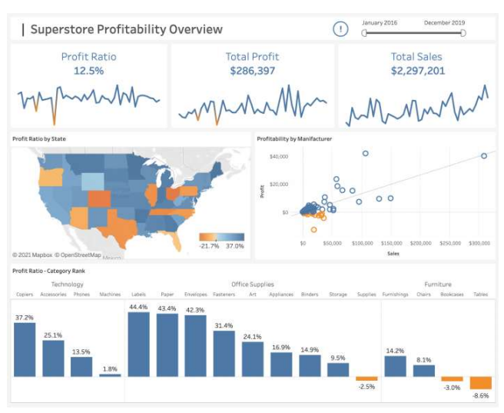
Results

Slide 16

LINKS
GITHUB-Links:-
https://github.com/ShubhamKJ123/Analysis-of-Superstore-Database.git
Here are some references for sales analysis on Superstore dataset:
•Chakraborty, M. (2020). Sales Analysis of Superstore using Power BI. Kaggle. https://www.kaggle.com/moumoyesh/sales-analysis-of-superstore-using-power-bi
•Microsoft. (n.d.). Analyse and visualize Superstore data in Power BI. https://powerbi.microsoft.com/enus/tutorials/analyze-and-visualize-superstore-data/

Slide 17

Research Paper
Analyse and visualize Superstore data in Power BI
Sales Analysis of Superstore dataset using Power BI
Analyse and visualize Superstore data in Power BI
A review of sales forecasting models for retail industry
A comparative analysis of machine learning algorithms for sales forecasting in retail industry

Slide 18
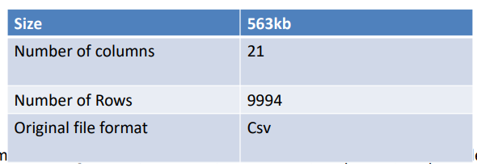
DATA SET
Data set URL:
https://www.kaggle.com/datasets/vivek468/superstore-dataset-final
About the dataset: The dataset provides information about the sales and profit from a supermarket.
Column details:
['Row ID', 'Order ID', 'Order Date', 'Ship Date', 'Ship Mode', 'Customer ID', 'Customer Name', 'Segment', 'Country', 'City', 'State', 'Postal Code', 'Region', 'Product ID', 'Category', 'Sub-Category', 'Product Name', 'Sales', 'Quantity', 'Discount', 'Profit']

Slide 19

# Step-1: Importing the dataset
# Importing libraries
import pandas as pd
import numpy as np
df=pd.read_csv("/content/drive/MyDrive/IBM_Project/Superstoredataset.csv", encoding='cp1252')
Df
• Checking data type and missing values:
df.info()
Read the columns or Features of the dataset:
df.columns
Null Value check:
df.isna().sum()
• Read the Duplicate value:
df.duplicated().sum()

Slide 20
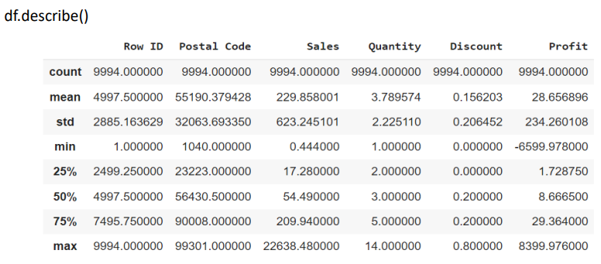
Some statistical information
Understanding the distribution of the data: The mean, min, max, and other metrics provide a quick overview of the distribution of the data
Data normalization: The mean and std values can be used to normalize the data
Feature scaling: The min, max, and other values can be used to scale the features to a suitable range

Slide 21
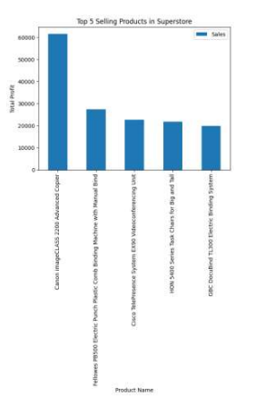
# Step-2: Exploratory Data Analysis – EDA
What are the top selling products in the superstore?
# Group the data by Product Name and sum up the sales by product product_group = df.groupby(["Product Name"]).sum()["Sales"] product_group.head()
top_5_selling_products.plot(kind="bar")
# Add a title to the plot
plt.title("Top 5 Selling Products in Superstore")
# Add labels to the x and y axes
plt.xlabel("Product Name") plt.ylabel("Total Profit")
# Show the plot
plt.show()

Slide 22
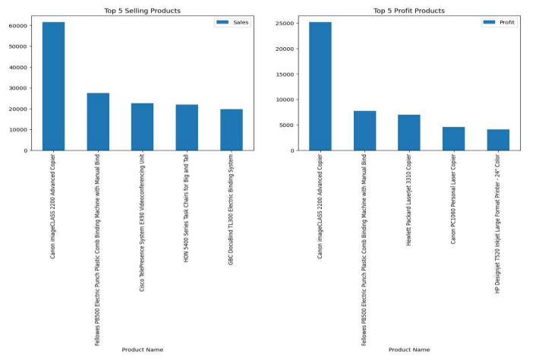
Are the top-selling products the most profitable?

Slide 23
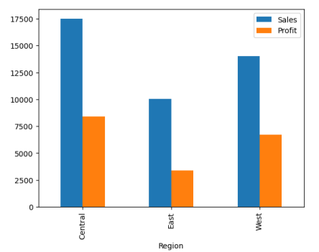
What is the total Sales and Profit by region?
Filter the data to only include the Canon imageCLASS 2200 Advanced Copier product = df[df["Product Name"] == "Canon imageCLASS 2200 Advanced Copier"]
Group the data by Region region_group = product.groupby(["Region"]).mean()[["Sales", "Profit"]]
• Ploting region_group.plot(kind="bar")
plt.show()

Slide 24
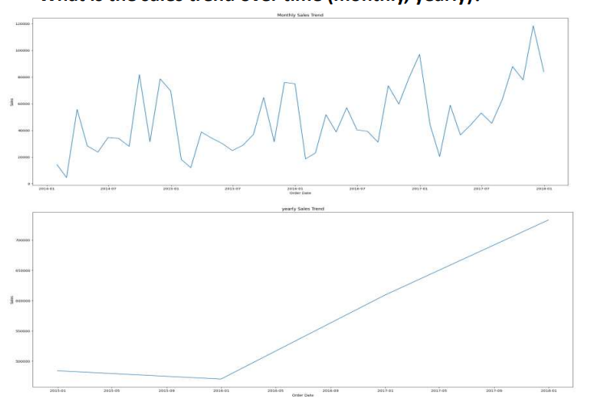
Sales Generated by Statewise

Slide 25
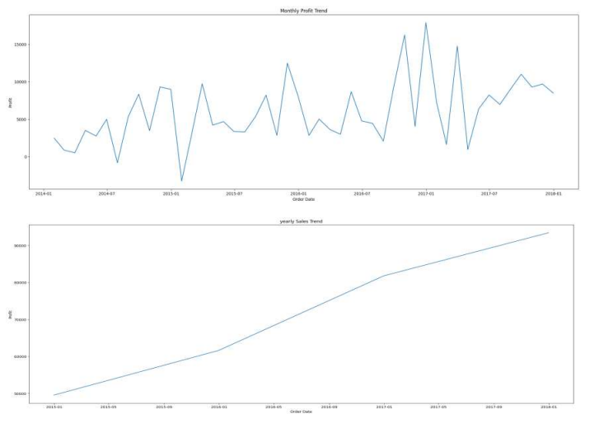
Profit over time:

Slide 26
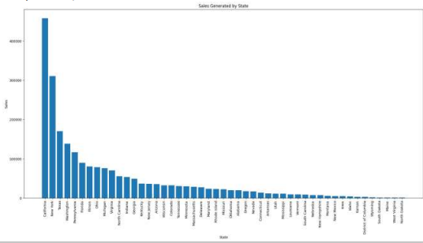
Sales Generated by Statewise:
state_sales = df_places.groupby(['State'], as_index=False).sum() state_sales.sort_values(by='Sales', ascending=False, inplace=True)
plt.figure(figsize=(22,10)) plt.bar(state_sales['State'], state_sales['Sales'], align='center',) plt.xlabel("State") plt.ylabel("Sales") plt.title("Sales Generated by State")
plt.xticks(rotation=90)
plt.show()
state_sales

Slide 27

Select top 5 cities by sales and Sort the data by
sales in descending order

Slide 28
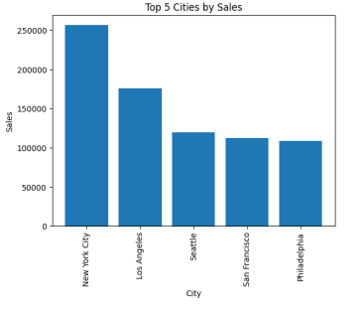
Query & Visualization
city_sales = df_places.groupby('City', as_index=False).sum()
Sort the data by Sales in descending order:
city_sales.sort_values(by='Sales', ascending=False, inplace=True)
Select the top 5 cities:
top_5_cities_sales = city_sales.head() plt.bar(top_5_cities_sales['City'], top_5_cities_sales['Sales'], align='center')
• plt.xlabel("City")
• plt.ylabel("Sales") plt.title("Top 5 Cities by Sales") • plt.xticks(rotation=90)
• plt.show()
top_5_cities_sales

Slide 29
Select top 5 cities by profit and Sort the data by
profit in descending order

Slide 30
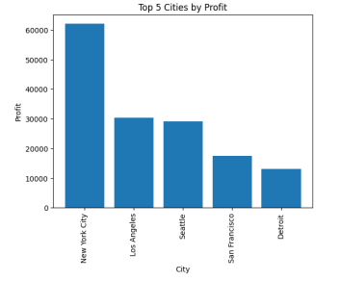
Select top 5 cities by profit and Sort the data by profit in descending order:
city_profit = df_places.groupby('City', as_index=False).sum()
# Sort the data by Sales in descending order: city_profit.sort_values(by='Profit', ascending=False, inplace=True)
# Select the top 5 cities: top_5_cities_profit =city_profit.head() plt.bar(top_5_cities_profit['City'], top_5_cities_profit['Profit'], align='center')
plt.xlabel("City") plt.ylabel("Profit") plt.title("Top 5 Cities by Profit") plt.xticks(rotation=90)
plt.show()
top_5_cities_profit

Slide 31
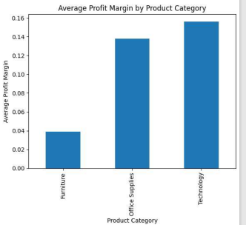
The best sales
# Group the data by product category and calculate the average profit for each category:
avg_profit_margin_by_category = df.groupby('Category')['Profit'].sum() print(avg_profit_margin_by_category) df['Profit Margin'] = df['Profit'] / df['Sales']
# Group the data by product category and calculate the average profit margin for each category:
avg_profit_margin_by_category = df.groupby('Category')['Profit Margin'].mean()
• # Plot the average profit margin for each category as a bar chart:
avg_profit_margin_by_category.plot(kind='bar')
• # Add a title and labels to the chart:
plt.title("Average Profit Margin by Product Category")
plt.xlabel("Product Category") plt.ylabel("Average Profit Margin")
plt.show()

Slide 32

CONCLUSION
The analysis of the Superstore dataset has provided valuable insights into sales trends, customer behavior, and operational efficiency
Through exploratory data analysis and advanced modeling techniques, we have identified several significant findings: •Sales Trends: The analysis revealed seasonal patterns, with peak sales occurring during specific months
Overall, the "Analysis of Superstore dataset" project demonstrates the power of data analytics in uncovering insights that drive strategic decision-making, operational efficiency, and ultimately, the success of the Superstore in a competitive retail market
Moving forward, it is recommended that the Superstore continues to monitor sales performance, customer behavior, and operational metrics. This will allow for ongoing adjustments and improvements based on changing market dynamics and evolving customer preferences.
Overall, the "Analysis of Superstore dataset" project demonstrates the power of data analytics in uncovering insights that drive strategic decision-making, operational efficiency, and ultimately, the success of the Superstore in a competitive retail market

